Slide 1

Session - 1
Organization : TeachToTech
Instructor : Ayush Raj
Duration : 1.5 hr
(knight @leetcode, 4 ★@codechef, Specialist @codeforces)

Slide 2
Welcome to the World of C Programming
What You'll Master Today
Today's Agenda
This session covers the essential building blocks that form the foundation of C programming. You'll gain hands-on experience writing actual code and understand how your programs come to life.
Introduction to C and its importance
Structure and anatomy of C programs
Your first "Hello World" program
Program vs. Process concepts
The compilation pipeline
Variables, keywords, and data types

Slide 3

Why Learn C? The Foundation of Modern Computing
The Foundation
Blazing Speed
Modern languages like Python, Java, and C++ are all built on top of C. Understanding C means understanding how these languages work under the hood.
C is extremely fast and efficient, making it the go-to choice for gaming engines, operating systems, and high-performance applications.
System Control
C provides direct access to computer hardware—memory, CPU, and more. This low-level control is essential for system programming.

Slide 4
The Structure of a C Program
Every C program follows a specific structure—think of it as a recipe that must be followed exactly. Miss a part, and your code won't run.
01
02
#include <stdio.h>
int main()
The Toolbox: This header file contains pre-built tools like printf() so you don't have to write everything from scratch.
The Start Button: This is where your program begins. The computer looks for this function to start executing your code.
03
04
{ } Curly Braces
return 0;
The Boundaries: All your program logic must live inside these braces. They define the scope of your main function.
The Exit Status: This tells the operating system that your program finished successfully without errors.

Slide 5
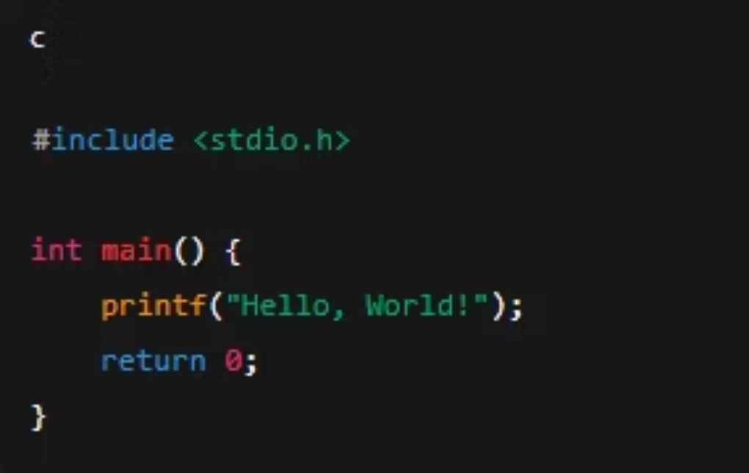

Your First Program: Hello World
Let's Write Code!
Type this code into your compiler exactly as shown. Pay attention to every character.
Don't forget the semicolon (;) at the end. it tells the compiler where each statement ends.

Slide 6
Program vs. Process: A Critical Distinction
Understanding this difference is very essential.
Program: The Passive Entity
A file stored on your hard disk
Contains instructions but isn't running
Think of it as a recipe book sitting on a shelf
Static and unchanging until executed
Process: The Active Entity
The program currently running in RAM
Actively executing instructions
Think of it as cooking the meal from that recipe
Dynamic and consuming system resources

Slide 7

The Compilation Process: From Code to Execution
Computers only understand binary (0s and 1s). The compiler translates your C code into machine language through four distinct stages.
Writing the Source Code
We write the program in C language. This code is written by humans, not understood by the machine.
Preprocessor
Cleans up the code by removing comments and expanding macros. Prepares your code for translation.
Compiler
Translates your C code into Assembly Language—a low-level, human-readable form.
Assembler
Converts Assembly into Machine Code—the binary language computers understand.
Linker
Connects your code with library files to create the final executable (.exe) program.

Slide 8

Keywords vs. Variables: Understanding the Rules
Keywords
Variables
Reserved words owned by the C language. You cannot use them as variable names because they have special meanings.
Named containers you create to store data. You choose the names following C's naming rules.
int - integer data type
age - stores a person's age
return - exit function
marks - stores test scores
float - decimal data type
salary - stores income amount
if - conditional statement
grade - stores letter grade

Slide 9
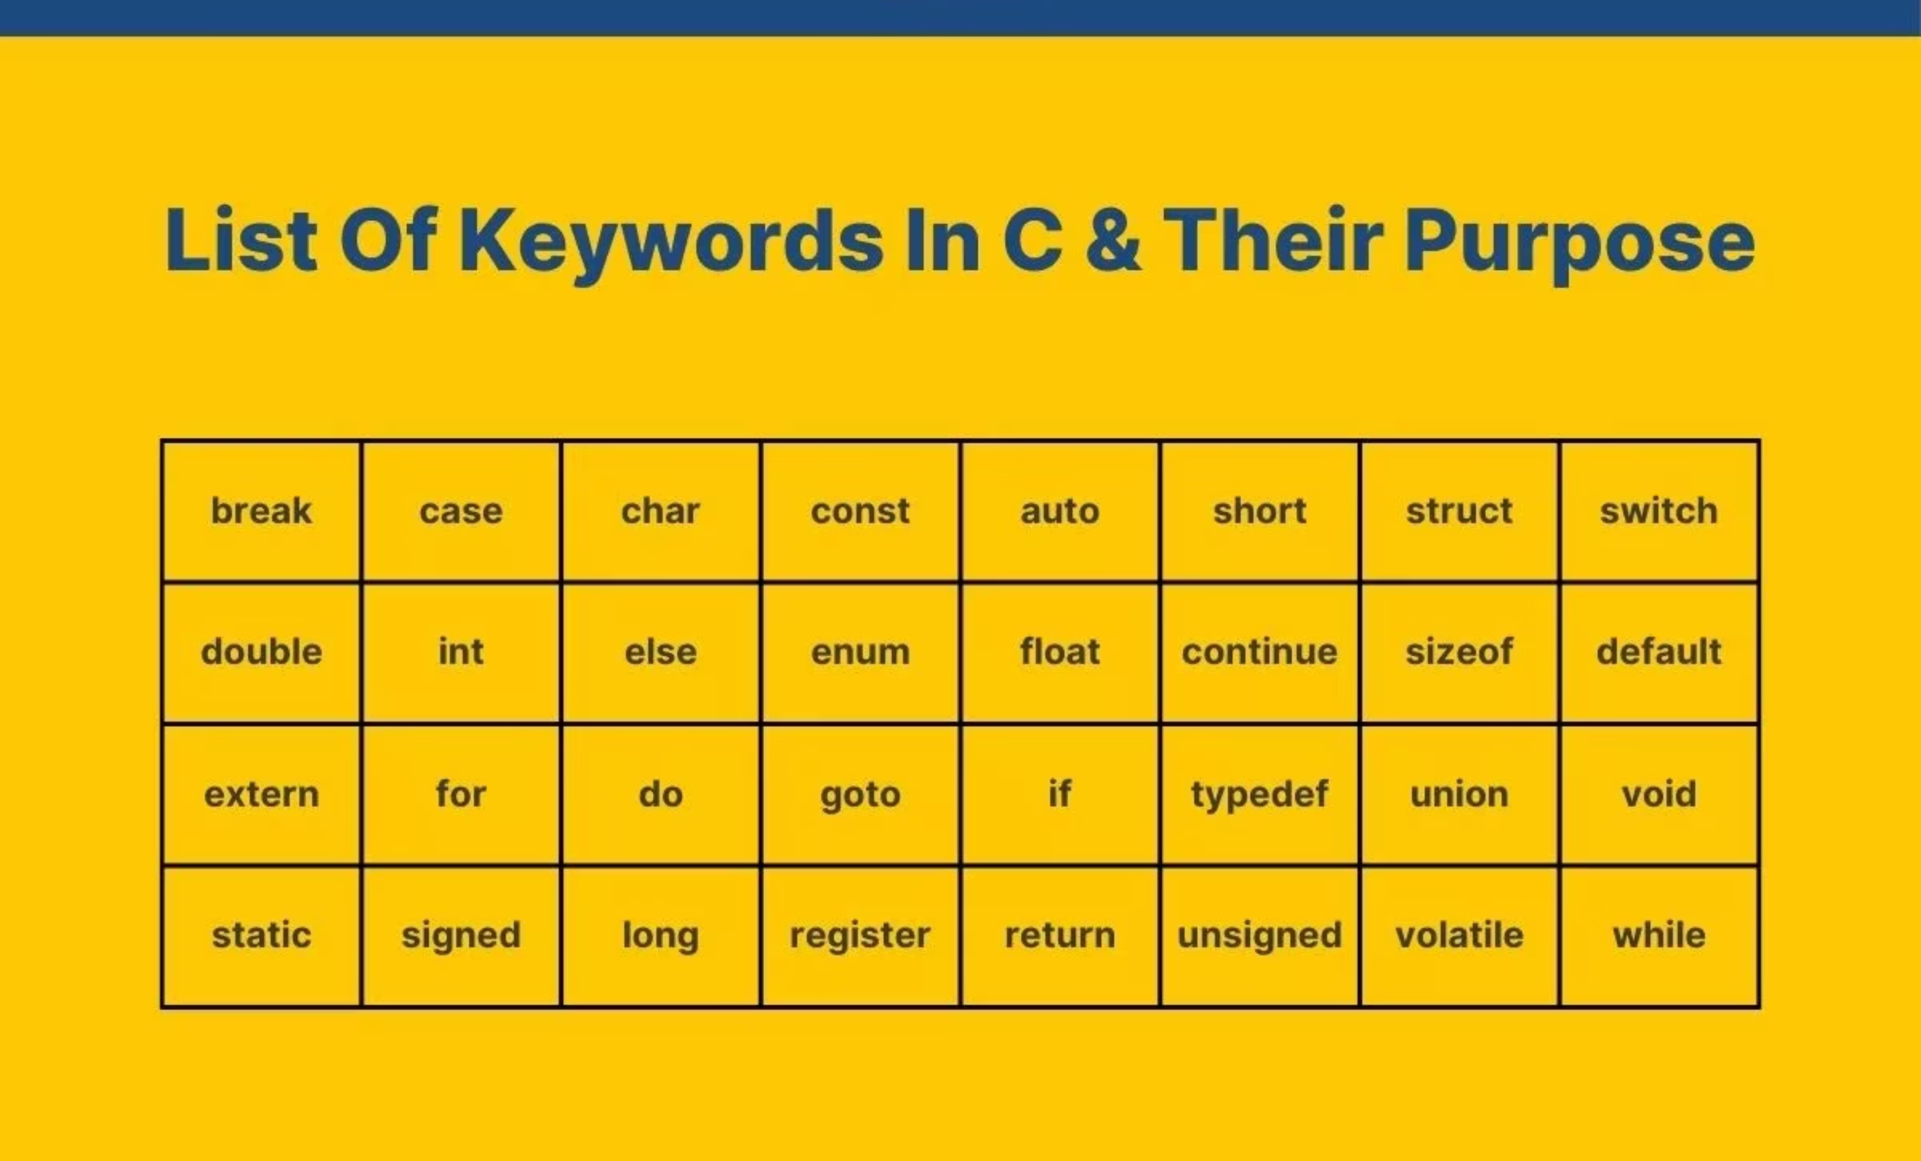
Keywords :

Slide 10
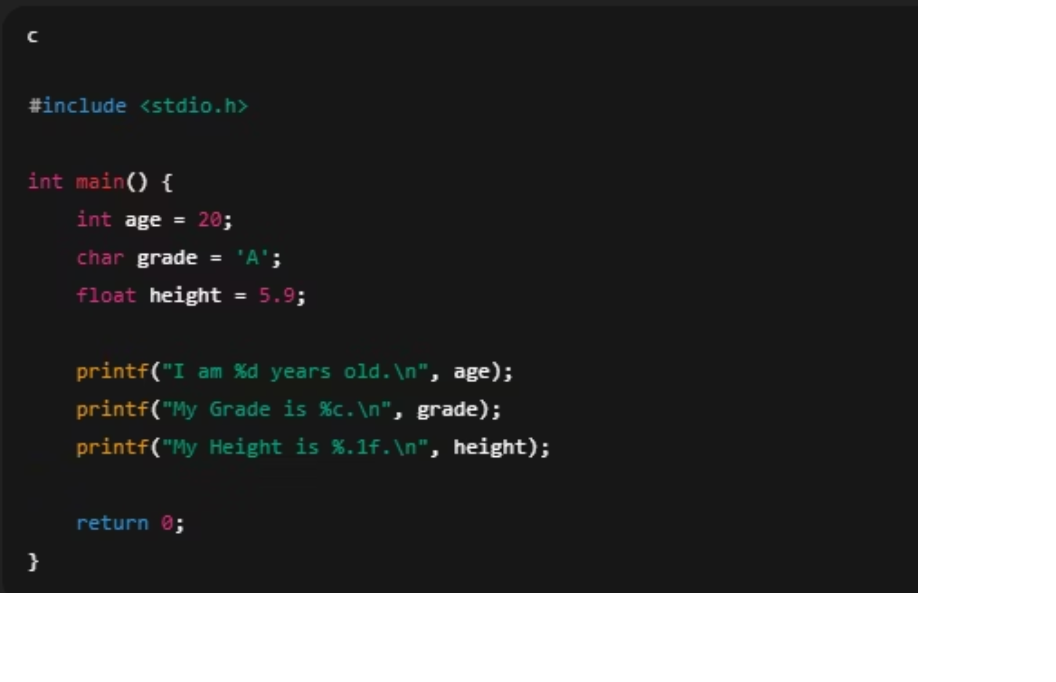
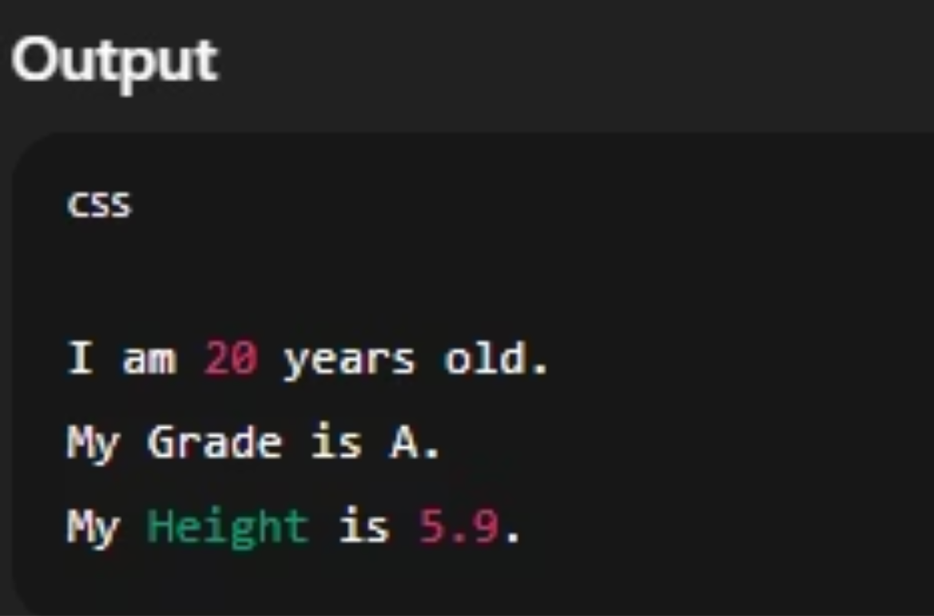
Data Types: Choosing the Right Container
Data types tell the compiler what kind of information you're storing and how much memory to allocate. Think of them as different-sized boxes for different items.
Data Type
Description
Format
Examples
int
Whole numbers (integers)
%d
10, -5, 0
float
Decimal numbers
%f
3.14, 98.6
char
Single character
%c
'A', 'z', '$'
double
Large/precise decimals
%lf
3.14159265

Slide 11




codechef problem QR
Problem 1
Problem 2
Problem 3
Problem 4
Practice Printing in C
Hello World!! in C
Hello World! Question in C
Valid Code Block Usage in C

Slide 12

Your Homework Challenge
1
2
3
Set Up Your Environment
Homework 1
Homework 2
Install a code editor on your personal laptop. Recommended options: VS Code,.
Create a C program that prints two things: the first letter of your name and your year of birth using appropriate data types.
Create a C program that prints your name, age, class, cgpa, year, branch using appropriate data types.

